Slide 1
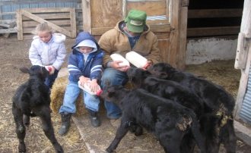
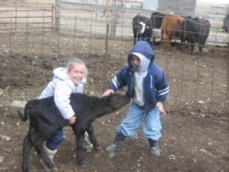
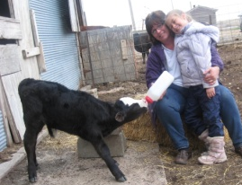
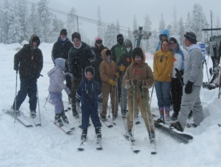
Digital Storytelling
Sandy Nightingale
Computer Camp
June 3-4, 2010

Slide 2
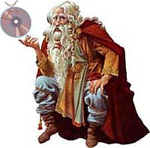
What is Digital Storytelling?
Digital Storytelling is using technology to create stories. You will combine pictures, sounds, music, your words, and your voice to create a digital story.

Slide 3
Step #1-Brainstorm an Idea for Your Story
Stories can be funny, silly or sad.
They can be full of facts or all made up.
The thing that most stories have in common is a problem the characters have to fix.
The fun part about writing a story is that YOU can decide how to fix the problem.

Slide 4
Elements of a Story
Characters
the people or animals in the story
Setting
when and where the story takes place
Theme
an important message the author is trying to share through the story
Plot
what happens in the story (a problem /conflict, events, and a solution are usually part of the plot)

Slide 5
The Ugly Duckling

Slide 6
Characters
A character can be anyone or anything - an animal, a person or even a rock!
The story is about the characters and what they do.
In Snow White, some characters are people, but the dwarves and animals are characters, too. Even the queen's mirror is a character.
Who is your story about?
What are your characters like?
Choose a character from the handout.

Slide 7
Setting
The setting is where and when a story happens.
A story can take place in the future or the past, at school or on the moon!
Many fairy tales take place "Long ago and far away."
Other stories have a real setting. For instance, cowboy stories are set a hundred years ago in the American West.
Where does your story take place?
When does your story happen?
Choose a setting from the handout.
Notes:
Your story needs a setting. Where and when does this story take place?
Is the setting important to the story? If not, don't spend too much time on it. For example, if the story is about two rocks in a shoe box, you probably don't need to spend a great deal of time describing the box, since your reader can easily imagine what that looks like.
If the setting is important, you want to show the reader what it would be like. For example, if you're setting your scene in the back alleys of Paris in July of 1777, you should help the reader understand what this would be like (hint: hot, stinky, dangerous).
Sometimes the setting is so important that it resembles another character in your story. For example, in a story about a penguin trying to cross Antarctica, the bird might encounter 'angry winds' and 'desperate loneliness' of never-ending nights. In other words, the reader would sense that the setting itself has emotions just like the characters.

Slide 8
Problem
A good story has a problem that the characters must solve.
The three little pigs have a hungry wolf.
The little engine that could has a mountain.
The tortoise and the hare have the same problem (racing to the finish line) but different ways of solving it.
What is your story's problem?
How does the problem make the characters feel?
Notes:
Every great story involves a problem or challenge to be solved by the characters. An interesting challenge is what turns a boring list of everyday events in to an interesting and exciting story for your readers. The challenge creates tension.
No matter how interesting your character and settings are -- you need an interesting problem to solve or your story will be B-O-R-I-N-G. For example: (go to next slide)

Slide 9
The Problem Makes Your Story Interesting
Boring: "Captain Fantastico woke up one morning, got dressed, brushed his teeth and went to school."
Better: "Captain Fantastico woke up one morning, got dressed, and brushed his teeth. On his way to school, he realized he'd left his lunch money on kitchen table. His stomach was already grumbling. How was he going to eat lunch?"
Awesome: "Captain Fantastico woke up one morning with a terrible headache and found that his arms had been tied into knots. No doubt this was the work of his arch enemy Dr. Futzengrapz. To make things worse, his lunch money had disappeared from kitchen table... again."

Slide 10
Obstacles in Your Story
Imagine the following:
Character: Mouse
Setting: House
Problem: Find Cheese
Motivation: Hungry
It's simple and boring. But what happens when you add obstacles?
Obstacles: Giant Mouse Trap, Three-legged Cat, Turbo Vacuum
Now it's getting interesting! Obstacles create tension and make the story fun for your reader.

Slide 11
The Ending
At the end of the story, the problem is solved.
Usually, the characters fix the problem, like the girl who says Rumpelstiltskin's name.
Sometimes something else happens to make the problem go away - a prince's kiss wakes up Sleeping Beauty.
After the problem is solved we learn what happens to the characters.
How is the problem solved in your story?
What happens to the characters?

Slide 12
Moral or Lesson
Has everything been resolved? Is it clear what will happen to your important characters after the story ends?
For example, do they live happily ever after?
How does your main character feel about the result?
How have your characters transformed?

Slide 13
Character Transformation
The Dr. Seuss's greedy Grinch becomes generous and loving when he realizes there's more to Christmas than just presents.
In the final scenes of Pinocchio, the puppet transforms physically into a boy, while his character also makes the final transformation from being a liar, and into someone that is trustworthy and brave.
Across all seven of the Harry Potter books, we see Harry, Hermione and Ron grow-up -- from small children into young adults. In each book, they learn life lessons about trust, honesty and friendship.

Slide 14
Story Theme Examples
good vs. evil
the importance of friendship
the problems with selfishness
the rewards of sharing
the danger of revenge
the consequences of bullying
the importance of honesty
achieving one's goals
respecting authority
travelling and journeys
following the rules
peer pressure
the value of taking risk

Slide 15
Lessons Learned in Stories
The grass is always greener.
Look before you leap.
A stitch in time saves nine.
If it's not broken, don't fix it.
A bird in the hand is worth two in the bush.
Don't make a mountain out of a molehill.
Don't put all your eggs in one basket.
The nail that sticks out gets hammered down.
Many hands make light work.
Barking dogs seldom bite.
It's darkest just before the dawn.
Don't cross a bridge until you come to it.
Don't burn your bridges.
The early bird gets the worm.
Don't change horses mid-stream.
All good things must come to an end.
Don't judge a book by its cover.
Don't cut of your nose to spite your face.
Rome was not built in a day.
Birds of a feather flock together.

Slide 16
Step #2-Develop a Script
Develop a Narrative Script
No more than one double spaced page
Go through the normal stages of writing-prewriting, rough draft, revising, editing, and final draft.
Start with an interesting beginning.
Little Red Riding Hooks PowerPoint
Planning your script
Story Web #1 Story Web #2
Story Board

Slide 17
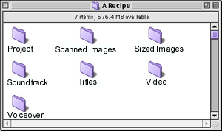
Step #3-Digitize Story Elements
Create organized files to store the story elements.
Collect images- Internet, scanned, SD cards, picture CDs, etc.

Slide 18
Step 4 – Put your Story Elements Together in Photo Story 3
Photo Story 3 – free download
Photo Story Tutorial

Slide 19
Pacing Your Narration
Pacing is the true secret of successful storytelling.
The rhythm of a story determines much of what sustains an audience’s interest.
A fast-paced movie with many quick edits and upbeat music can suggest urgency, action, nervousness, exasperation, and excitement.
Conversely, a slow pace will suggest contemplation, romanticism, relaxation, or simple pleasures.

Slide 20
Pacing Narration (cont.)
Changing pace, even in a short digital story, is very effective. Our narrative can have starts and stops, pauses, and quickly spurted phrases.
You can always change music tempo to build a sense of action or release.
Moving from a panning effect on a still image that slowly stretches out our concentration, followed by a burst of images in staccato succession, catches and holds our interest.

Slide 21
THE POWER OF SOUND
The sudden opening of the door becomes the prelude to disaster, when the swelling treble of orchestrated strings calls out suspense to our ears.
A sweetly flowing melody over two people looking at each other for the first time signals that these are the romantic characters we will be following in the plot.

Slide 22
Music
We know:
upbeat music means happy endings
slow and tremulous music means sadness is forecast
fast music means action
heroic music means battles and victorious heroes are likely
Instrumental music, whether it’s classical, folk, jazz, or ambient, is often better suited than lyrical music to the style and meaning of the story’s text and visual narratives.

